Slide 1

Lets Make Complaints Better?
Nicola Williams, Assistant Director of Nursing &
Patient Experience ABMU Health Board

Slide 2
A Complainants Story
Oct 2012- Letter received from parents of a lady in her early 20’s regarding the care received prior to her sad death in June 2012
Graded as ‘amber’ complaint
At time backlog in responding to complaints
Sept 2013- complaint picked up by Senior Nurse asked to oversee dept- no work had started – complex -involved GP & a number of HB services
Dec 2013 response sent to family & offered a meeting (14 months after complaint received) – family rang wished to meet

Slide 3
May 2014 -Meeting held with parents –
Clinical Director went through all the questions the parents had - communicated well & clearly & concisely what had happened, lessons learnt, actions taken & changes put in place
At the end of the meeting - family thanked everyone very much for being so open & honest and explaining everything to them. They made it very clear that if we had arranged a meeting when they sent the letter (19 months earlier) they would have been able to move on following their daughters death - but up to that point they had not had closure.

Slide 4
February 2014
Some complaints unanswered for over a year- longer
Not meeting PSOW deadlines
Poor relationship CHC advocates
Little clinical oversight / scrutiny
Very Hard working department –each had high case load (over 100 each)- Handlers managing complaints, redress, inquests, claims, ombudsman – claims took precedence
Welsh Risk Pool Assessment 2013/14- 35% lessons learnt

Slide 5
Complaints ‘Handled’ (email chase!!)
Cumbersome, bureaucratic paper chase! With defensive / negative responses not always answering all issues raised
Not always keeping in contact with complainants
Staff at ‘grass roots’ not clear how to handle concerns
Not Independent
‘Passing the hot potato!’

Slide 6
Management & Response not proportionate
Protracted sign off process
Not always following up on promises
Issues not ‘nipped in the bud’ & allowed to escalate
Ward Staff / Managers telling people who were
unhappy to write to the Chief Executive
Not always feeding back to families after a serious incident investigation
Not meeting NHS Redress regulations:
        Breach duty care / qualifying liability
        Timescales
        Contact / expectations
        Holding letters
        Independent reviews

Slide 7
End Results
Unnecessary formalisation & escalation of concerns
Complaints taking far to long to resolve
High level complainant dissatisfaction
Many complainants coming back unhappy or just Give up & loose faith
Distress to complainants (often bereaved)
Loss of trust / fear – hiding something
Poor Organisational Reputation
39 open Ombudsman Investigations – a number of Section 16 /17 outcomes
Spirals out of control -National Media interest

Slide 8
So What Did we do??
Whole Scale Culture Change starting from the Top of the Health Board- Chief Executive & Chairman
  Raising profile of importance of complaints
  Strengthening clinical accountability & responsibility for complaints management & learning lessons
  Clear Escalation processes
  Executive Board attention
  Link governance performance into finance & target performance review processes
  Set up complaints Clinics each site – CEO /
  Executive Team with a senior clinician

Slide 9

The Gift of Complaints
A complaint is a gift of feedback from a service user. They have taken time and trouble to communicate with us about how they think and feel about care & treatment provided- often under very difficult circumstances.
This gift, while it may not be comfortable to receive, is hugely valuable.

Slide 10
Culture
Don’t get it wrong in the first place!
Create a culture where every individual is devoted to excellent service and service recovery is an instinctive reaction
Empower every individual to resolve complaints
NOT ignore problem / ‘go to ground’
Work with patients & families to get it right
Admit and apologise when things have gone wrong
Explain fully if things have not gone wrong – don’t be defensive
Consider appropriate redress
Special Care with bereaved – especially unexpected deaths

Slide 11
Full Change Programme:
  Assistant Director dedicated clinical leadership to drive the organisational change programme
  Realign Executive Responsibility
  Dedicated finances
  Can do attitude – not taking no for an answer!
Getting the Foundations Right
  New Datix (patient safety system)- live 1st Dec 2014 fully integrated Datix web – live ward- board dashboard reporting & enhanced meaningful clinical codes
  Patient Focussed- Department of Investigations & Redress become Patient Feedback team
  Redesign the central team – the right people doing the right job with the right tools & support in the right way

Slide 12
Re-designed Team
Dedicated Serious Incident Team (3) do all serious incident (harm / death) investigations
Dedicated Ombudsman Clinical Lead
Dedicated claims, inquest & redress team- all legally trained
Dedicated Complaints Team- 50% clinically trained staff (therapists / nurses)
Sufficient Admin Support
Getting case numbers right – 15 open complaints
More senior staff on emails (band 4’s)
Dedicated customer care / nipping issues in
bud / telephone aggression trainer

Slide 13
Education / Training & Support
Ensure all staff trained to do the job their are being asked to do
RCA training
Dedicated specialist Investigation training
Customer Care / nipping issues in bud training front line staff
Mandatory Complaints & redress training for all managers & governance staff
POVA training

Slide 14
Revised Complaints Processes
Speedy Resolution Waiting List / appointment complaints
Immediate contact on receipt of letter – have discussion / discuss requirements & expectations, apologise & agree way forward- fantastic difference – e.g. 50% closure of ED complaints
Develop a relationship of trust with complainant
Keep to all promises
Offer meeting with senior clinicians to discuss
issues

Slide 15
Clinical triage of all formal complaints – each complaint assessed individually – lead nurse & medical speciality leads taken active lead role
Clinical Independent Investigation Team – Nursing
Urgent work to address backlog
Very Senior review all response letters
Full engagement of CDs / Locality Directors
Mandatory Directorate / Locality Board detailed complaint analysis
Patient Advisory Liaison Service 7 days – 9am-8pm successfully introduced into one acute hospital site – support for staff, patients &
their loved ones

Slide 16
Don’t raise expectations – be clear what will be delivered and by when – especially if historical
Proportionate investigation using relevant RCA Tools- arrange an RCA meeting to get as many parties together
Earlier commissioning of external / peer review
Scope out all relevant national / care / NICE standards / guidelines- clear what you are measuring against

Slide 17
Raising profile of need to consider breach of duty of care / qualifying liability
Ensuring 30 & 60 day response timescales uppermost in everyone’s minds
Not allowing jargonistic, negative & defensive responses to go out
Treating complainants & their issues as you would wish for yourself or your family- always put ourselves in their shoes
Ensure all staff escalate anything they cannot handle / not sure of / not getting support for immediately
Ensure Accountable & Responsible Officer /s ‘sign off’(before final sign off)- THIS SHOULD
NOT BE DELEGATED

Slide 18
Working on proactive contact with bereaved families
Patient Support Officers advising bereaved if at any point they have any questions to contact Patient Feedback team / PALs
Small cards being produced

Slide 19
Proactive Patient Feedback Mechanisms
Rolling out Friends & family Test across whole Health Board- feedback cards/ smart device/ feedback zones
Weekly feedback to each clinical area
Ensuring changes made as a result of feedback
Email alerts from agreed buzz words for immediate action

Slide 20
Investigative approach
Notes called on day complaint arrives- scanned & emailed to all relevant staff & clinical leads
Arrange a RCA / Review meeting around key staff’s availability – within 2 weeks – allow enough time to do a full review at meeting and agree response- support to do drafting at meeting
Full RCA for red and amber’s – formal statements- these are the only ones that should take up to 60 working days
Clinical Independence instigated – not
marking own homework

Slide 21
Responses
What went wrong
Why went wrong
What going to do to stop it happening again
Explore & Explain Breach of duty of care & Qualifying liability (if harm or possible harm alleged)
Chronologies only if required to explain a point (can be a small part of the investigation report – not main element)
Peer Review
When timescale >6 months offer of ex gratia payment up front and apologise poor complaints
handling

Slide 22
Response Checklist
Have we sought the complainants expectations and confirmed these?
Thank for raising concern; sincere apology; explanation; remedy
Are our conclusions clearly expressed?
Have we visible evidence against each conclusion?
Is the report presented in an easy to read format
Is our language written to be understood by the complainant?
Is it free from spelling and grammatical errors

Slide 23

Watch out for Brown M & M ‘s

Slide 24
Being Clear what Sign Off Means
Accountable Officer signing off that they were confident that:
The investigation has been clinically robust and undertaken ‘independently’
Outcome is clinically robust and clear
Complainants expectations have been sought and met
Response is not defensive, offers appropriate & meaningful – not ‘I am sorry you feel that...’
Response written in plain English

Slide 25
All complaints citing possible / actual harm have been investigated in line with redress & full redress outcome explanation given & appropriate redress offered (or a plan if interim response)
You have ensured action taken to prevent re-occurrence within area concerned (and wider as appropriate)
You have identified any themes / trends and taken appropriate action

Slide 26
Key Messages
We are all accountable & responsible
Make superhuman efforts to nip complaints in the bud & respond within timeframes
All front-line staff trained in handling complaints. Listen/sympathise/don’t justify (don’t want to know) /agree action (make notes. What to do about it?)/follow through (make sure it happens)
Action plans must be signed off and implementation monitored through Directorate / Locality Boards
There MUST be ward – Board monthly themed
analysis

Slide 27
Early contact / meetings actually saves time – it definitely does not take longer - prevents rework & memory is better
Senior scrutiny & support
Staff have to be held to account
After we go beyond 3 months we start loosing trust
Clinical oversight & a level of clinical independence is essential
Special Care is required proactively with bereaved – especially unexpected deaths – opportunity for explanations
PALs work as a support to staff & patients
nipping issues in the bud

Slide 28
So what difference has this made?
Continued Board level priority
Culture changes are underway- We are on a Journey
Improved escalation processes are working
201 less formal complaints April-Dec 2014 than 2013
Positive Feedback WHLS / CHC / PSOW
Half the number of open complaints
16 less open Ombudsman Cases – no S16/17 last 11 months
Less second resolution complaints
Backlog almost eradicated -Increasing 30 & 60 day compliance & most now responded within 6 months
Increasing positive proactive patient Experience Feedback at least 95% would recommend ward / unit

Slide 29

QUESTIONS!

Slide 30
Complaints Handling
Wrexham County Borough Council

Slide 31
Exchanging Best Practice with other Local Authorities
Regional & National working groups
Links to other groups
Network of support – formal & informal
Collaborative working
‘One voice’

Slide 32
Improvements to Complaint Management at WCBC
Adoption of ‘All Wales Complaints Policy’ in 2012
Centralised Complaints Team
Based in Customer Services department
Reduction in PSOW investigations

Slide 33
Statistics

Slide 34
‘Tricks of the Trade’
Robust recording tools
Independence from services
Build rapport with teams / managers
Don’t be defensive
Seek advice
Have open discussions with the PSOW
Publicise the procedures

Slide 35
Barriers to Managing Complaints Well
Culture – complaints seen as a negative
Informal complaints – not recording trends
‘Compensation culture’
Guidance & Regulations don’t always support early or appropriate resolution

Slide 36
The bigger picture…
Steve Porter,
Operations Director

Slide 37
A bit about us at Wales & West Housing
A change in our approach to complaints
The bigger picture – the right culture

Slide 38
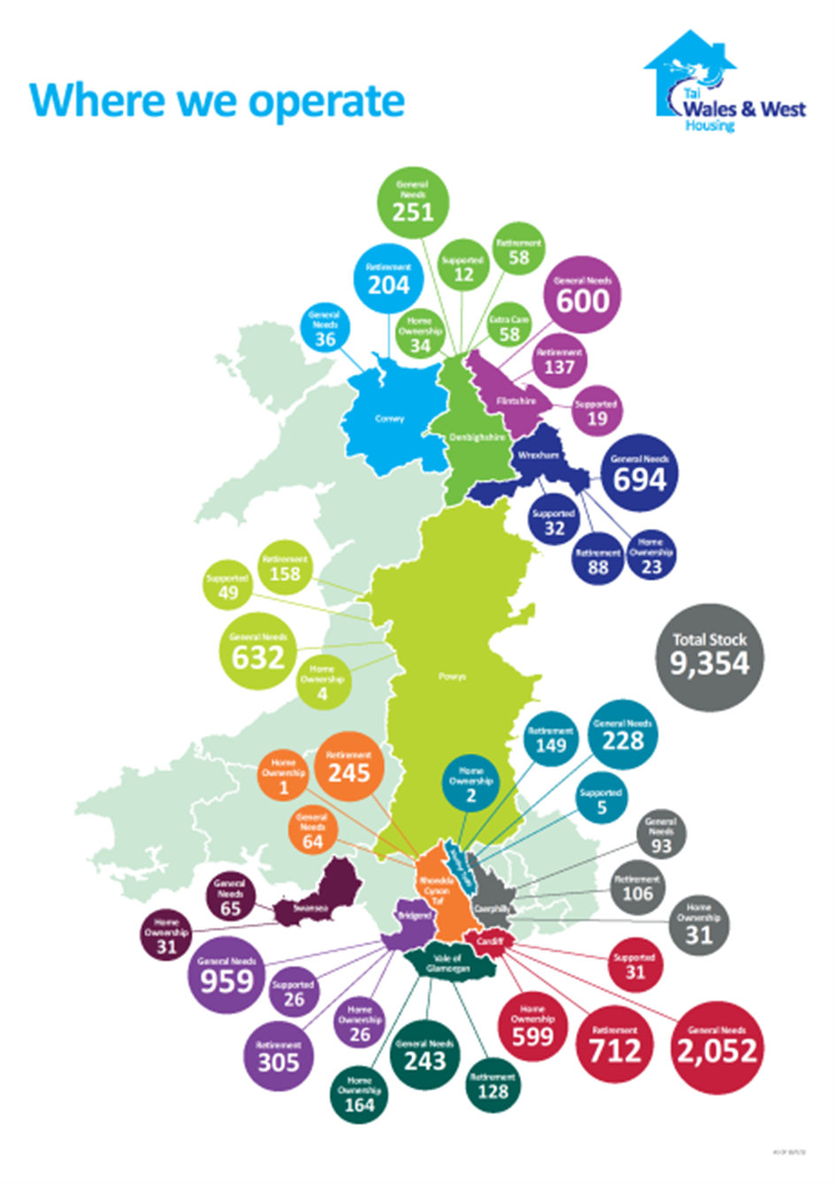
    About us
    Traditional Housing Association
    9,700 homes across Wales
    25,000 residents
    12 local authority areas
    Traditionally constructed properties, WHQS compliant, in small schemes
    Ongoing development programme
    ST Best Companies, 5th in UK
    Investors In People, Gold
    Systems thinking approach

Slide 39
Our approach to complaints
Traditional 3 stage complaints procedure
Welcome comments, compliments and complaints
In 2012 we changed to a 1 stage procedure
A clear, simple 1 stage procedure
Complex rules result in simple behaviour
Simple rules result in complex behaviour

Slide 40
Complex rules = simple behaviour
Simple rules = complex behaviour
3 Stage Process | 1 Stage Process
Focus upon the process steps | Focus on the issue and the outcome
Focus on the timings and triggers | Focus on what matters to the customer
Controlled and inflexible approach | Flexible approach
More adversarial | More solution orientated
Less staff support needed | More staff support needed

Slide 41
Complex rules = simple behaviour
Simple rules = complex behaviour
3 Stage Process | 1 Stage Process
Focus upon the process steps | Focus on the issue and the outcome
Focus on the timings and triggers | Focus on what matters to the customer
Controlled and inflexible approach | Flexible approach
More adversarial | More solution orientated
Less staff support needed | More staff support needed

Slide 42
Complex rules = simple behaviour
Simple rules = complex behaviour
Support for staff when dealing with complaints
A clear, simple policy
A clear, simple process
Clear principles for dealing with a complaint
Clear guidelines on writing a reply
Mentors and enablers there to help
Clear requirements
No blame – usually the system not the person
The bigger picture – the right culture

Slide 43
Complex rules = simple behaviour
Simple rules = complex behaviour
Support for staff when dealing with complaints
A clear, simple policy
A clear, simple process
Clear principles for dealing with a complaint
Clear guidelines on writing a reply
Mentors and enablers there to help
Clear requirements
No blame – usually the system not the person
The bigger picture – the right culture

Slide 44
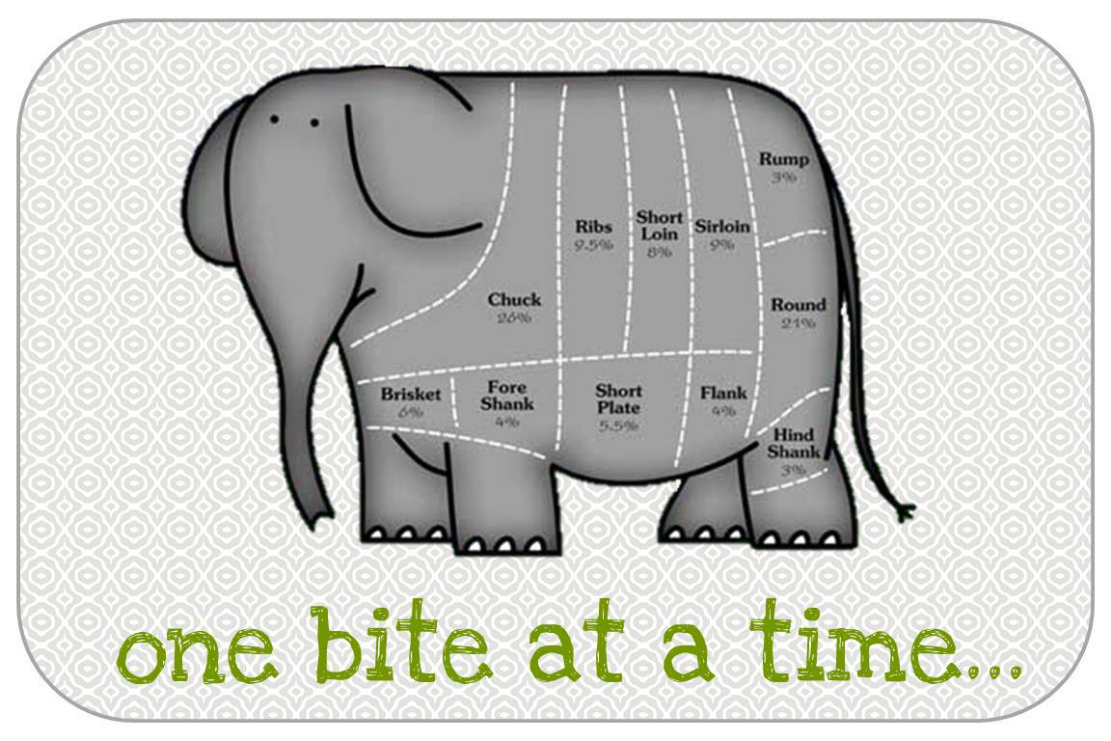
The Bigger Picture – the right culture
Getting it right more and more often,
Notes:
What is a complaint
We will get it wrong - inevitable

Slide 45
Getting it right more and more often
_{No blame}
_{(genuinely)}
_{Vision}
_{Culture}
_{Leadership}
_{Development}
_{Operating Principles}
_{Reality}
_{Values}

Slide 46

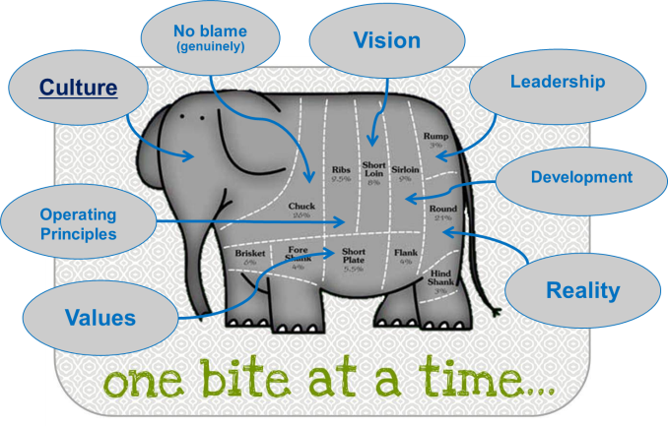
Vision – and reality
Our vision….
“Strong sustainable growth to make a difference to people’s lives, homes and communities

Slide 47
Vision – and reality
Our vision….
“Strong sustainable growth to make a difference to people’s lives, homes and communities

Slide 48
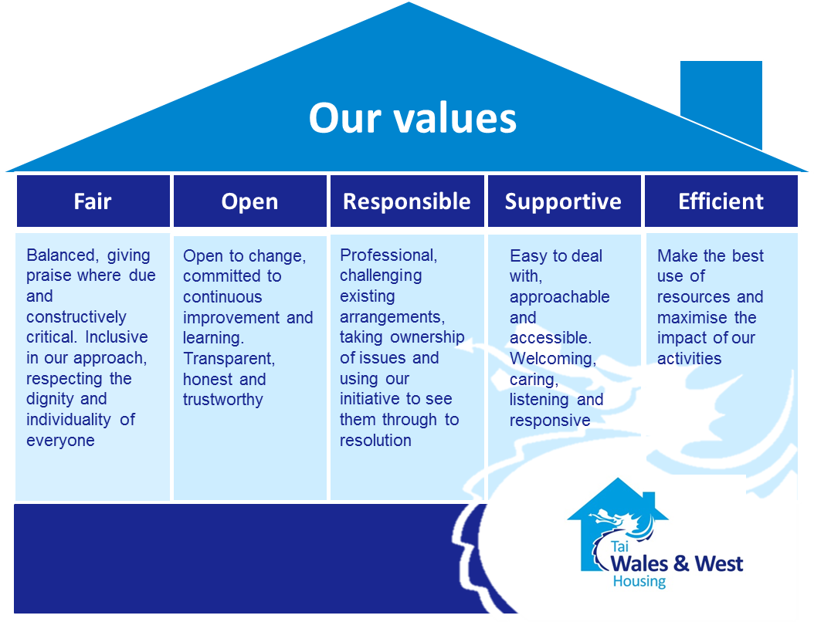
Values – and reality
May the FORSE be with you !

Slide 49
Values – and reality
May the FORSE be with you !

Slide 50
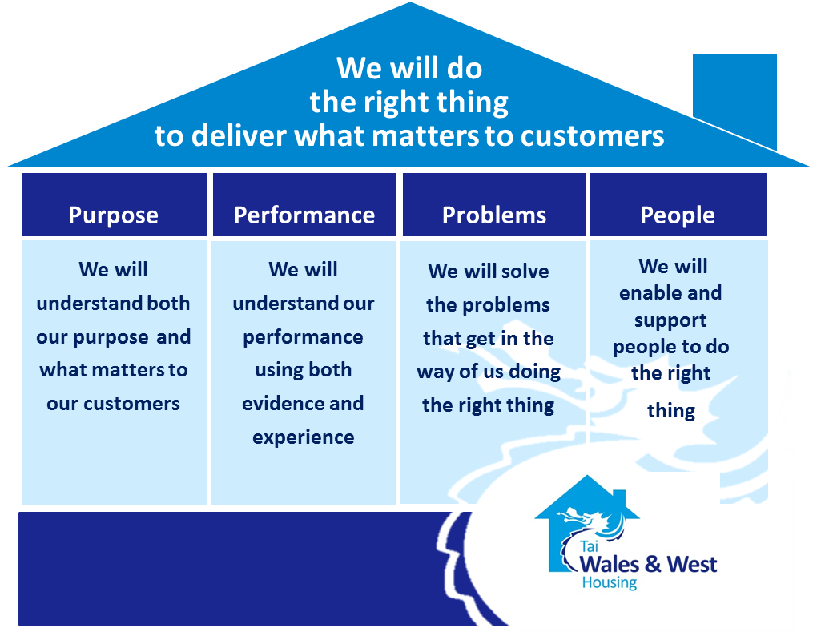
Operating Principles – and reality
Doing the right thing
The 4 P’s

Slide 51
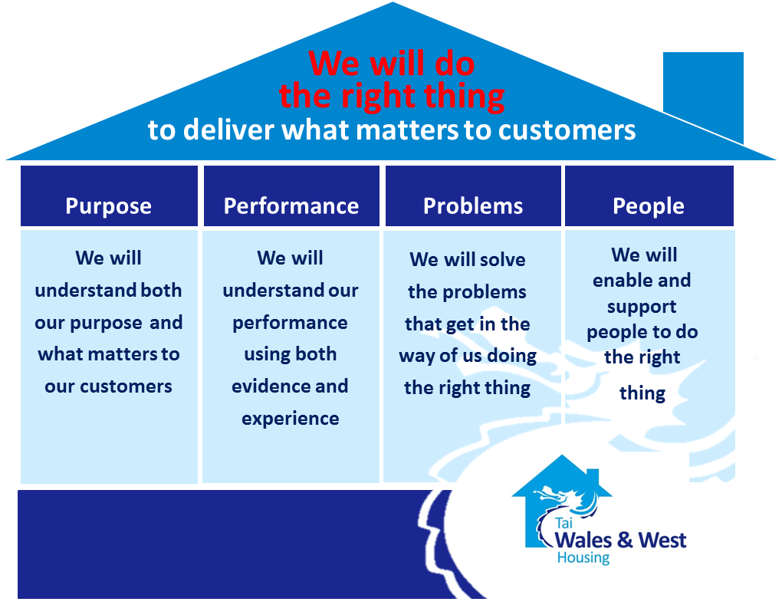
Operating Principles – and reality
Doing the right thing
The 4 P’s

Slide 52

Leadership – and reality
Leadership
Model
Leaders at WWH…

Slide 53

Development – and reality
Developing Heroes to Make a Difference
Leaders at WWH…..
Development conversations

Slide 54
Getting it right more and more often
_{No blame}
_{(genuinely)}
_{Vision}
_{Culture}
_{Leadership}
_{Development}
_{Operating Principles}
_{Reality}
_{Values}

Slide 55
….so finally
A clear, simple 1 stage complaints procedure
Simple rules/principles = complex behaviour
Support for staff
The right culture – with no blame
A focus on getting it right more and more often
Lots more elephant to eat……

Slide 56
_{Eat me…..}

